Slide 1

加拿大政府疫情补贴及日常福利--------CCANB
-----翻译整理内容仅供大家参考，最终以政府发布的细节为准

Slide 2
Brief Introduction of Vivian Qi
戚玮简介
2018 Sun Life Financial Advisor 2018年永明理财顾问
2017 Mutual Fund License 2017年 基金认证
2015 Landed in Fredericton 2015年 登录弗莱
2014 and before HR Manager in Qingdao Broadcast and TV Station 2014年前 青岛广播电视台财务经理、人事经理
2005 Graduated from California State University Fullerton with MBA 2005年 毕业于加州州立大学 MBA
2003 and before IT Manager and Web Developer 2003年前任IT经理和网站开发
1999 Graduate from Communication University of China (EE) 1999年毕业于中国传媒大学 电子工程专业

Slide 3
We Will Discuss
内容简介
疫情期间个人福利
疫情期间企业福利
其他日常政府福利

Slide 4
加拿大及NB 省Covid 19 期间个人福利汇总
福利项目 | 福利数额 | 申请条件 | 相关信息 | 适用人群（需满足条件）
 |  |  |  | 雇员(含工签) | 小企业主 | 自雇 | 学生
Canada Emergency Response Benefit 联邦应急补贴 | 每月$2000 最多4个月 | 1.年满15岁；2.因疫情失业、生病、隔离、照顾生病家人或孩子无法上班的人士；3.去年或者12个月之内有$5000收入4.第一次申请，已经或将要停止工作在第一个四周(3月15日-4月11日；4月12日-5月9日）内连续14天或更长时间内工作或自雇收入收入低于1000的；之后的申请，在整个4周中没有工作或预期会保持这个状态，工作或者自雇收入不足1000；或者是2019年12月29日之后至少领过一周的EI,但是EI额度已经用尽。 | 登陆CRA My account 申请或电话申请。4月6日起按生日月份排申请时间 | Y | Y | Y | Y
Wage Boost for Essential Workers | 等待细则 | 月收入不足$2500的重要岗位员工 | 待定
Canada Child Benefit Increase 增发牛奶金 | 一次性$300/孩子 | 有孩子的家庭 | 根据2018年报税收入，5月份发放 | Y | y | Y | Y
One Time Special GST Credit 一次性GST退税 | 一次性，最多$400/人， $600/夫妻 | 中低收入 | 根据2018年报税收入，4月9日发放 | Y | Y | Y | Y
NB Workers Emergency Income Benefit NB省应急福利 | 一次性$900 | 1.年满18岁；2.NB居民；3.因疫情失去收入，符合EI或联邦应急补贴申请条件人士 | service NB网站或电话申请 | Y | Y | Y | Y
Residential Property Tax Credit 房产税退税 | 省税部分（provincial portion） | 在NB省有主居所； | 可向前追溯3年，Service NB 网站或邮寄申请表 | Y | Y | Y | N/A
Property Tax Allowance 低收入房产税补贴 | 最多$300 | 1.在NB省有主居所；2.家庭年收入低于$30,000； | 可向前追溯3年， Service NB网站或邮寄申请表 | Y | Y | Y | Y
New Brunswick Low-Income Seniors’ Benefit NB省低收入长者补贴 | 一次性$400 | 符合老年金项目之一：低收入补贴(GIS),丧偶补贴(Allowance for the Survivor),联邦补贴(Frederal Allowance) | Service NB网站或邮寄申请表，4月1日起申请 | N | N | N | N
Emergency Bridging Fund 学生应急资助金 | 最多$750 | 因疫情经济困难的大学生，包括留学生 | 通过学校申请 | N | N | N | Y

Slide 5
加拿大及NB 省Covid 19 期间企业福利汇总
福利项目 | 福利数额 | 申请条件 | 相关信息 | 适用人群（需满足条件）
 |  |  |  | 雇员(含工签) | 小企业主 | 自雇 | 学生
Canada Emergency Wage Subsidy 紧急工资补贴 | 75%员工报酬,不超过$847每周每位员工；持续12周，从3月15日到6月6日，可以100%退还期间为员工支付的EI,CPP等；如果也符合10%TWS,TWS补贴额回从CEWS中扣除 | 1.与2019年同比或2020年1、2月平均收入比较，3月收入下降15%，4、5月下降30%;2.员工是非直系亲属 | 登陆CRA My Business Account 申请 | N | Y | Y | N
Temporary Wage Subsidy 临时工资补贴 | 10%员工报酬，3月18日到6月19日，三个月合计每位员工不超过$1375，总数不超过$25000。算企业应税收入 | 1、任何私营个人、组织或加拿大控股企业；2、3月18号前在CRA有注册号，工资账户；3、给员工发工资、分红等其他报酬 | 无需申请。每月交所得税时扣除即可。 | N | Y | Y | N
Canada Emergency Business Account 紧急企业借款 | 4万借款，2022年12月31日前还清，免息，有可能免最多1万的本金。 | 公司在加拿大营业；2020年3月1日前成立；有联邦税号；2019年工资支出在2万至150万之间；在金融机构有活跃账户；一家借款人不得在多家金融机构借款；非政府、慈善、宗教、工会等组织，不能从事非法活动 | 企业开户银行在线申请 | N | Y | Y | N

Slide 6
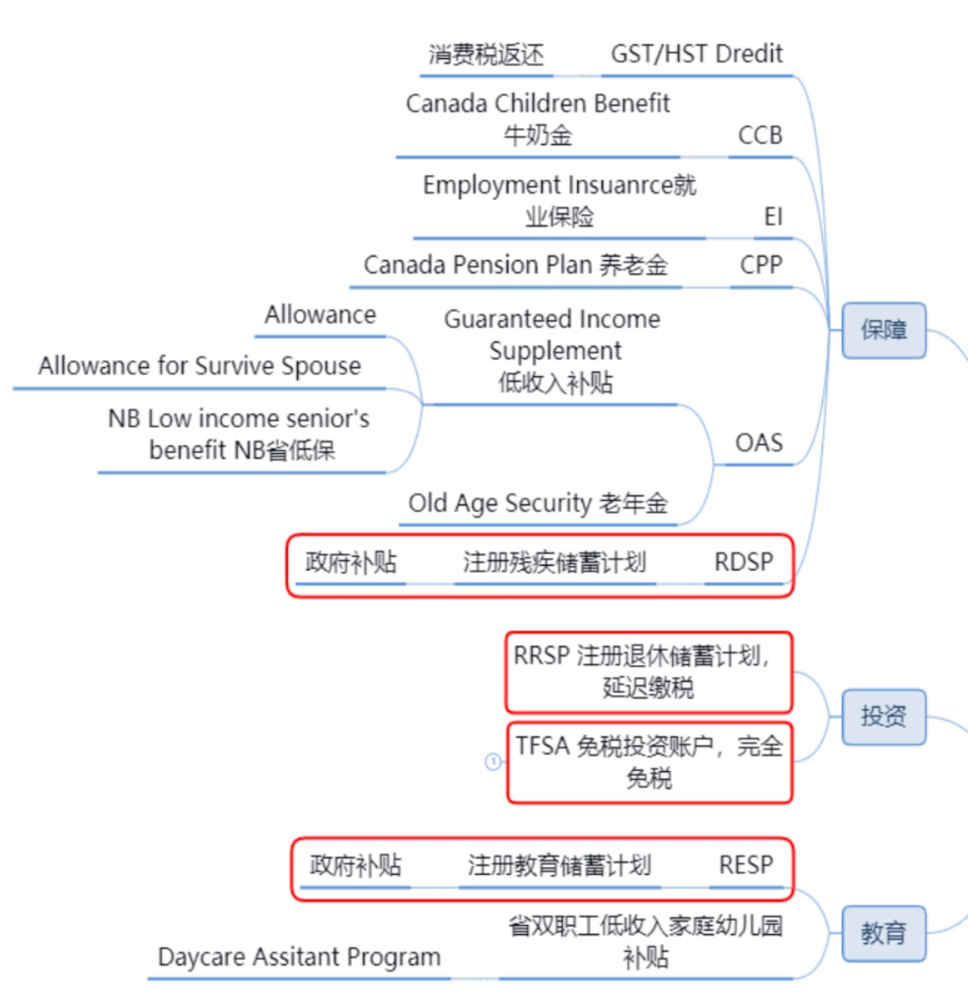
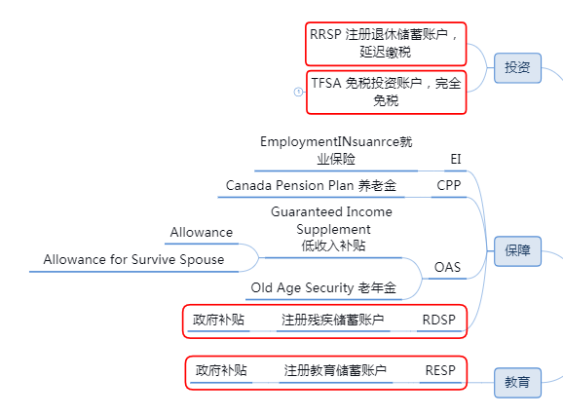
Government Benefit
政府福利

Slide 7
Government Benefit 政府福利
CCB Canada Children Benefit
牛奶金
GST/HST Credit 消费税返还
第一次申请一般需要提交三年收入（按每年平均汇率计算加币收入）；
一方非税务居民，也需提供海外收入；
EI Employment Insurance 就业保险（失业金）
雇主与员工每月分别缴纳（雇员1.62%）；
52周内工作满910小时（特殊情况600个小时）；
非过错离职2周后；
个人平均收入55%，最高$562/周
可领取14周-45周
家庭收入（net income）、18岁以下孩子年龄及数量计算;
2019年7月-2020年6月----------2018年1月-12月收入；
Notes:
Each family is eligible to receive a maximum annual benefit of $6,400 per child under 6 years old and a maximum of $5,400 per child between the ages of 6 and 17.
Employment Insurance (Federal)
Maximum Annual Insurable Earnings $51,700 $53,100
Premium Rate (Employee) 1.66% 1.62%
Premium Rate (Employer) 2.324% 2.268%
Maximum Annual Premium (Employee) $858.22 $860.22
Maximum Annual Premium (Employer) $1,201.51 $1,204.31
Maximum Weekly Benefit $547 $562
申请手续
当你一旦失业，应尽快申请普通就业保险金。你可以亲自到居住附近的加拿大服务处采用办事处所提供的计算机申请，分区方法是以邮区号码首三个字来划分，详情可点此参阅官方网站或查阅电话簿蓝页于 Government of Canada 之下的 Service Canada 办事处。也可以直接点此网上申请。若你不懂英语，可带一位能替你翻译的人士前往。申请当日，你应携带以下证明文件：
（1）两张个人身份证明文件，包括工卡，驾驶执照，枫叶卡或公民证，护照或其他身份证明文件。
（2）过去一年内所有雇主所发出的就业记录（Record of Employment）。若你在停工后14天内还未收到就业记录的话，你应先作申请，日后再补交数据给就业保险办事处，这便不会影响你领取失业金的生效日期。
（3）若你不能提供全部所需的就业记录，可递交过去的工资单或有关的工作证明。
（4）如你过去两年有领取过劳工赔偿金或工资损失保险金的话，也需出示这些证明文件。
（5）如你因健康问题而不能工作，必须出示医生证明书。
（6）如希望把失业保险金直接存到个人户口，请提供银行帐户资料或一张"Void"支票。
不论你目前或过去一年内，曾因为自动辞职或被雇主开除而失去工作，你必须要多填一份表格，详细解释理由。当就业保险办事处收到你的申请后，便会进行审查，决定你是否合资格领取失业津贴，及可领取的金额及期限。
等候期
申请一经批准，申请人要经过两个星期无津贴的等候期，其就业保险金才会生效。如在等候期间有工作收入，将会在首三个星期的津贴金中扣除。
报告卡
申请就业保险金后，你需要每两个星期填写报告卡，申报你每个星期的工作情况、工资、有否接受技能训练、是否愿意及可以工作、有没有其他收入等。你可通过电话，网站，或邮寄的方法填写报告卡。这份报告卡需要在指定日期递交给就业保险办事处，以避免你的失业保险金被延误或终止。
在提供所需数据及递交报告卡后约四个星期左右，你将会收到第一张失业金的支票（或自动转账）。之后，就业保险办事处将每两个星期发出保险金。
要工作多久才合资格申请就业保险金？
不论你的工作性质是全职，兼职，季节性或临时性，只要有向就业保险金供款，就可将你申请失业金前五十二个星期内的工作时数加起来，如果达到以下要求，便合资格申请：
（1）若你首次加入劳动市场及首次申请失业津贴，必须在过去五十二个星期内至少工作 910 个小时。
（2）若你离开就业市场超过两年，现正重新加入工作行列的话，你也须要在过去五十二个星期内有工作至少 910 个小时。
（3）若申请特别津贴金如怀孕、育儿及患病津贴或照顾病危亲属津贴，则须在过去五十二个星期内曾工作 600 个小时。
（4）除以上情况外，一般申请人士必须在过去五十二个星期内或自上次领取失业津贴金后（以较短时期作准）曾工作 420 至 700 个小时．确实要求的时数，则视乎你现居住的城市的失业率及你过去的工作纪录而定。失业率愈高，相对时数的要求愈少。
（5）若你以前曾违反就业保险金的规例，你可能需要较多的工作时数才合资格申请。
津贴金额
基本的津贴金额是你平均收入的 55％，而最高的每周金额为 $413。但如果你是低收入人士（即每年收入低于 $25，921），需要供养子女并正在领取加拿大儿童税补助金的话，你可领取的失业金比率会超过 55%。
在计算平均收入方面，有以下二种方法：
（1）过去二十六个星期的平均工资。假如你过去二十六个星期都有工作的话，平均工资就是将过去二十六个星期所赚取的工资加起来再除二十六个星期。
（2）假如你过去二十六个星期中，只工作数星期的话，平均工资的计算方法是将二十六个星期内所赚取的总收入，除一个特定的最低除数（Minimum Divisor），这除数是根据不同失业率而定。例如，你所居住地区的失业率是 8.1% 至 9% 的话，这除数是19。如果你过去26星期中只工作了17个星期的话，平均工资的计算是将过去二十六个星期的总收入除这19除数，而不是除17个星期。因此，在计算你过去二十六个星期的平均工资时，会考虑你真正工作多少个星期及最低除数，而将你总收入除较高的数目。
领取津贴金的期限
你可以领取多长时间的失业金要视乎以下的情况：
（1）你所居住地区的失业率
（2）你过去五十二个星期里或自上次领取就业保险金起计曾工作多少个小时，以较短时期作计算
你工作时数愈多的话，可领取的时间则愈长，但最高是 45 个星期，而最少是 14 个星期。

Slide 8
Government Benefit 政府福利
Daycare Assistant Program 托儿费补贴
其他福利
多元文化中心英语学习；
就业辅导（Employment Counseling) ；
家庭收入（net income）低于$55,000的NB省双职工、学生或其他情况如残疾居民；
孩子0-12岁在参与该项目的幼儿园或者课后班（after school）就读；
根据家庭收入计算补贴，实际托儿费超出部分父母负担；
在多元就读也算学生，多元的幼儿园对于学生免费
NB省社会福利局 Social Development Department https://www2.gnb.ca/content/gnb/en/departments/social_development.html

Slide 9
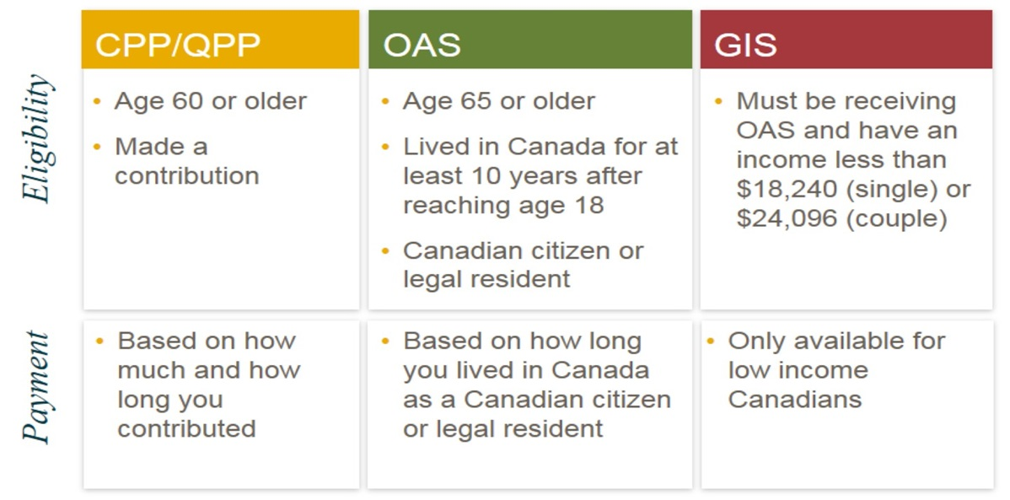
Government Benefit 政府福利
CPP Canada Pension Plan 退休金
OAS Old Age Security
老人金
GIS Guaranteed Income Supplement 低收入补贴
NB Low Income Senior’s Benefit NB省低保（$400)
Notes:
Government pensions are not automatic. You must apply in advance to receive most pensions - generally about six months before you're eligible to receive benefits.
Don't short-change yourself. Know exactly how much you're entitled to receive from government sources before you retire.
Your accountant, the Income Security Programs department of Human Resources Development Canada and/or your provincial social services department can help you determine your eligibility and benefits.
Canada/Quebec Pension Plan (CPP/QPP)
If you worked and contributed to either the Canada Pension Plan or the Quebec Pension Plan, you are entitled to receive pension benefits under these plans. Full details are available on the Human Resources Development Canada Web site.
Benefits
The actual amount of your benefit is based on the number of years you contributed and on your pensionable earnings during that period.
Benefits generally amount to 25% up to 33% by 2023 of your average annual job earnings over your lifetime, up to an annual maximum. Income is paid monthly and indexed to inflation annually.
In 2014, the percentage of low earnings was increased to 17%, allowing up to 8 years of your lowest earnings to be dropped from the calculation, which will likely increase your benefit amount.
Maximum Annual Pensionable Earnings $55,900 $57,400
Basic Exemption Amount $3,500 $3,500
Contribution Rate (Employee/Employer) 4.95% 5.10%
Maximum Annual Contribution (Employee/Employer) $2,593.80 $2,748.90
Old Age Security (OAS)
Eligibility for the Old Age Security pension and the Guaranteed Income Supplement
(https://www.canada.ca)
The Old Age Security (OAS) pension is a monthly payment available to most Canadians 65 years of age who meet the Canadian legal status and residence requirements.
If you are living in Canada, you must:
be 65 years old or older
be a Canadian citizen or a legal resident at the time we approve your Old Age Security pension application, and
have resided in Canada for at least 10 years after turning 18.
Guaranteed Income Supplement
The Guaranteed Income Supplement (GIS) provides a monthly non-taxable benefit to Old Age Security (OAS) pension recipients who have a low income and are living in Canada.
Maximum Monthly Pension $607.46
Maximum Monthly Guaranteed Income Supplement Benefits:
Single, widowed or divorced pensioner $907.30
Spouse/common-law partner receives OAS pension $546.17
Spouse/common-law partner does not receive OAS pension $907.30
Spouse/common-law partner receives the Allowance $546.17
Maximum Monthly Allowance Benefits:
Spouse/common-law partner receives GIS and OAS pension $1,153.63
Surviving spouse or common-law partner $1,375.17
"Claw back Provision"
OAS benefits are subject to a "claw back provision" which requires high-income pensioners to repay all, or a portion of their OAS benefits.
Under this claw back provision, individuals with annual net income of approximately $77,580 for 2019 ($75,910 for 2018) must begin repaying their OAS benefits at the rate of 15% or the excess over this amount. OAS benefits disappear completely for those with annual net income of roughly $122,843 (2019) or more.
Other Pensions and Supplements
Low-income pensioners may be eligible for other pensions and supplements offered through the federal government including:
Guaranteed Income Supplement (GIS)
Spouse's Allowance
Widowed Spouse's Allowance . In certain circumstances, some pensioners may also be eligible for provincial income supplements to subsidize their Old Age pension and GIS. Health and Welfare Canada or your provincial social services department can provide full details

Slide 10
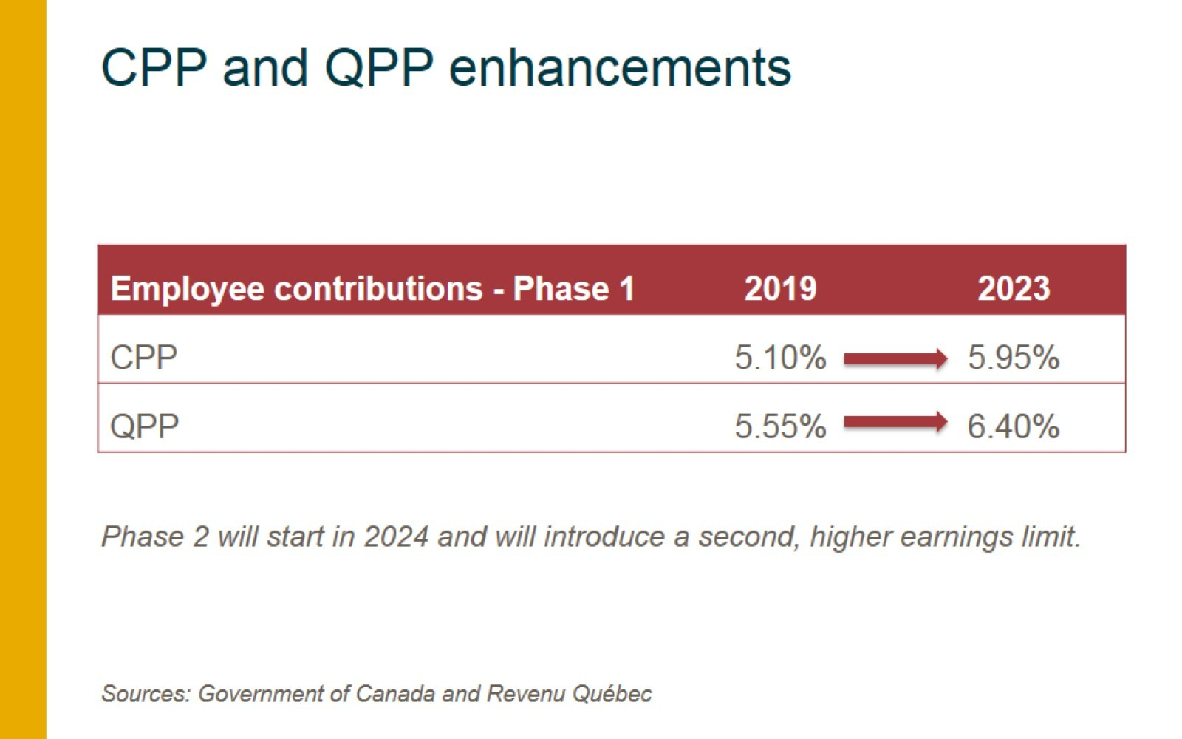
CPP and QPP enhancements
Notes:
Starting in 2019, the Canada Pension Plan (CPP) and Quebec Pension Plan (QPP) are being gradually enhanced. This is designed to result in higher benefits in your retirement years as a result of higher annual contributions being paid.
Phase 1
CPP (https://www.canada.ca/en/services/benefits/publicpensions/cpp.html)
From 2003 to 2018, employees contributed 4.95% on their earnings to the CPP. Employers made an equal contribution. From 2019 to 2023, the contribution rate for employees will gradually grow, culminating in an increase of one percentage point (from 4.95% to 5.95%) on earnings between $3,500 and the year's maximum pensionable earnings limit($57400 increased from $55900). Employers will pay the same increase in contributions as their employees.
2018: 4.95%
2019: 5.10%
2020: 5.25%
2021: 5.45%
2022: 5.70%
2023: 5.95%
QPP
https://www.canada.ca/en/revenue-agency/services/tax/businesses/topics/payroll/payroll-deductions-contributions/canada-pension-plan-cpp.html
As of January 1, 2019 the Québec Pension Plan will be comprised of 2 plans:
The base plan (the current plan) where employees and employers each contribute 5.4% for the portion of earnings between $3,500 (the basic exemption) and the maximum pensionable earnings (MPE).
The additional plan, where additional contributions are paid by the employees and the employers according to a rate that will see a gradual increase from 2019 to 2023.
Quebec employers deduct the Quebec Pension Plan (QPP) contributions instead of CPP contributions.
As a result of Quebec Pension Plan (QPP) enhancements the QPP contribution rates for employers and employees will be 5.55% starting on January 1, 2019 (on earnings between $3,500 and the year's maximum pensionable earnings limit.)
2018: 5.40%
2019: 5.55%
2020: 5.70%
2021: 5.90%
2022: 6.15%
2023: 6.40%
Phase 2
Starting in 2024, a second, higher limit will be introduced, requiring you to invest an additional portion of your earnings to the CPP/QPP. This new limit, known as the Year’s Additional Maximum Pensionable Earnings, will not replace the first earnings ceiling. Instead, it will subject your earnings to two earnings limits. The Year’s Additional Maximum Pensionable Earnings is referred to as the second earnings ceiling.
You will pay 4% on the difference between the two earnings ceilings. For example, let’s assume that the estimated first earnings ceiling in 2025 is $69,700 and the second earnings ceiling is $79,400 (approximately 14% higher than the first earnings ceiling). If you earn between $69,700 and $79,400 you will contribute on $9,700, which is the difference between these two limits.
Employees and employers will each contribute at the rate of 4%, and self-employed individuals will contribute at 8%.

Slide 11
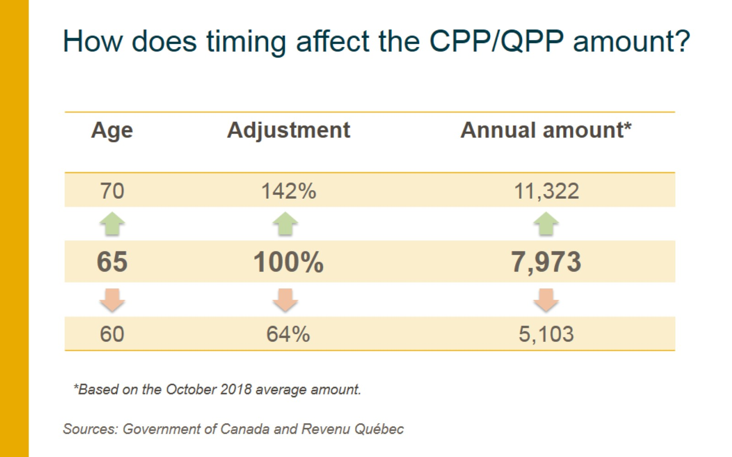
Notes:
Timing
Your CPP/QPP retirement amounts will depend on how much and for how long you have contributed to the CPP/QPP, and at what age you want your CPP/QPP retirement amounts to start.
The standard age for beginning to receive your CPP/QPP retirement amounts is the month after your 65th birthday. However, you can take reduced pension amounts as early as age 60, begin receiving "normal" pension amounts at age 65, or receive larger pension amounts by beginning receipts as late as age 70.
Taking your pension before age 65
If you take the CPP retirement pension early, it is reduced by 0.6% for each month you receive it before age 65 (7.2% per year). This means that, an individual who starts receiving their CPP retirement pension at the age of 60 will receive 36% less than if they had taken it at 65.
Taking your pension after age 65
If you take your pension late, your monthly payment amount will increase by 0.7% for each month after age 65 that you delay receiving it up to age 70 (8.4% per year).
This means that, an individual who starts receiving their retirement pension at the age of 70 will receive 42% more than if they had taken it at 65.
Deferring OAS
As of July 2013, you can defer receiving your Old Age Security (OAS) pension for up to 60 months (five years) after the date you become eligible for an OAS pension in exchange for a higher monthly amount. If you delay receiving your OAS pension, your monthly pension payment will be increased by 0.6 percent for every month you delay receiving it, up to a maximum of 36 percent at age 70.
Who will benefit from deferring their Old Age Security pension
People who earn more than the maximum annual income allowed for a given year will have to repay part of or their entire OAS pension. If they are able to delay receiving it until they have a lower income, they will be able to keep more of the OAS pension, and their OAS pension amount will be higher because of the increases for every month they delayed receiving it.
In deciding when to start receiving your OAS pension, you should consider your personal situation, taking into account such things as: current and future sources of income, employment status now and in the future health, and plans for retirement.

Slide 12
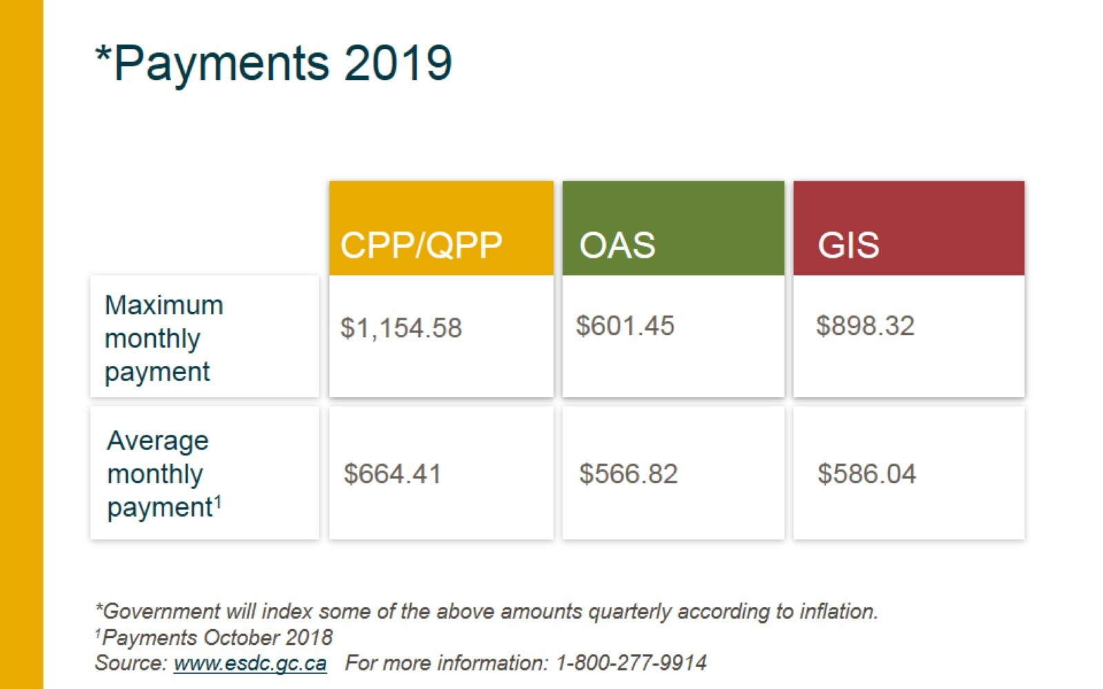
Notes:
Maximum Monthly Retirement Pension (at age 65) $1,134.17 $1,154.58
Maximum Monthly Post-Retirement Benefit (at age 65) $28.35 $28.86
Maximum Monthly Disability Benefit $1,335.83 $1,362.30
Maximum Monthly Survivor's Pension (younger than 65) $614.62 $626.63
Maximum Monthly Survivor's Pension (65 and older) $680.50 $692.75
Maximum Monthly Benefit for Children of Disabled
Contributor
$244.64 $250.27
Maximum Monthly Benefit for Children of Deceased
Contributor
$244.64 $250.27
Maximum Lump Sum Death Benefit $2,500.00 $2,500.00
Maximum Monthly Combined Benefits:
Combined Survivor's and Retirement Pension (at age 65) $1,134.17 $1,154.58
Combined Survivor's Pension and Disability Benefit $1,335.83 $1,362.30
Maximum Monthly Pension $607.46
Maximum Monthly Guaranteed Income Supplement Benefits:
Single, widowed or divorced pensioner $907.30
Spouse/common-law partner receives OAS pension $546.17
Spouse/common-law partner does not receive OAS pension $907.30
Spouse/common-law partner receives the Allowance $546.17
Maximum Monthly Allowance Benefits:
Spouse/common-law partner receives GIS and OAS pension $1,153.63
Surviving spouse or common-law partner $1,375.17
To find out how much CPP income you can expect, you can request a copy of your Statement of Contributions from Service Canada.
CPP payments: https://www.canada.ca/en/services/benefits/publicpensions/cpp/cpp-benefit/amount.html
OAS and GIS payments: https://www.canada.ca/en/services/benefits/publicpensions/cpp/old-age-security/payments.html
INTERNAL NOTE ONLY
Please note that average OAS and GIS monthly payments have been calculated based on the figures found in the Report “CPP/OAS Quarterly Report – Monthly Amounts and Related Figures From January to March 2019”
https://www.canada.ca/content/dam/canada/employment-social-development/migration/documents/assets/portfolio/docs/en/statistics/quarterly_report/isp-card-jan-march-2019-en.pdf
OAS average monthly payment, October 2018: $566.82=$3,525,900,000 / 6,220,519 (average monthly payment=amount paid/number of benefits).
GIS average monthly payment, October 2018: $586.04=$699,800,000 / 1,194,113 (average monthly payment=amount paid/number of benefits).
Starting in 2019, the Canada Pension Plan (CPP) and Quebec Pension Plan (QPP) are being gradually enhanced. This is designed to result in higher benefits in your retirement years as a result of higher annual contributions being paid.
Phase 1
CPP (https://www.canada.ca/en/services/benefits/publicpensions/cpp.html)
From 2003 to 2018, employees contributed 4.95% on their earnings to the CPP. Employers made an equal contribution. From 2019 to 2023, the contribution rate for employees will gradually grow, culminating in an increase of one percentage point (from 4.95% to 5.95%) on earnings between $3,500 and the year's maximum pensionable earnings limit($57400 increased from $55900). Employers will pay the same increase in contributions as their employees.
2018: 4.95%
2019: 5.10%
2020: 5.25%
2021: 5.45%
2022: 5.70%
2023: 5.95%
QPP
https://www.canada.ca/en/revenue-agency/services/tax/businesses/topics/payroll/payroll-deductions-contributions/canada-pension-plan-cpp.html
As of January 1, 2019 the Québec Pension Plan will be comprised of 2 plans:
The base plan (the current plan) where employees and employers each contribute 5.4% for the portion of earnings between $3,500 (the basic exemption) and the maximum pensionable earnings (MPE).
The additional plan, where additional contributions are paid by the employees and the employers according to a rate that will see a gradual increase from 2019 to 2023.
Quebec employers deduct the Quebec Pension Plan (QPP) contributions instead of CPP contributions.
As a result of Quebec Pension Plan (QPP) enhancements the QPP contribution rates for employers and employees will be 5.55% starting on January 1, 2019 (on earnings between $3,500 and the year's maximum pensionable earnings limit.)
2018: 5.40%
2019: 5.55%
2020: 5.70%
2021: 5.90%
2022: 6.15%
2023: 6.40%

Slide 13
RESP 注册教育储蓄计划
从受益人出生起至31岁每年可存，有效至35岁终身不超过5万；
可以开立家庭账户，多受益人共有，购买投资产品，投资收益递延缴税；
每年每个受益人存入前$2500政府的CESG补贴20%($500),最多一次可以补两年额度，补贴总额不超过$7200，可多受益人共享；
中低收入家庭且受益人03年12月31日之后出生的还$500的CLB(Canada Learning Bond)，总额不超过$2000,及$100补贴至15岁，仅供受益人本人使用；
受益人接受高等教育（post secondary education)时可取出EAP，增益部分在受益人名下缴税。如果非教育取出，补贴退还，增益缴税
Notes:
If an RESP beneficiary decides not to pursue post-secondary education, you have a few options.
Options for the RESP
If you have a family plan, some of the government incentives received can be used to fund the education payments to another beneficiary on the plan.
If you have an individual plan, you may be able to name an alternate eligible beneficiary.
If the beneficiary has reached age 21 and the plan is at least 10 years old, you can withdraw the earnings subject to a withholding tax and a 20% penalty tax unless transferred to an RRSP. The amounts withdrawn will be considered taxable income.
There are two types of withdrawal scenarios:
When funds withdrawn are used for education purposes
Once a student is enrolled in a qualifying post-secondary education or training program, the funds within the RESP can be paid out to the student with proof of enrollment. Payments comprised of accumulated income, grants and bonds are called Educational Assistance Payments (EAPs) and the student must claim them as income on their tax return. Contributions can be paid out the beneficiary tax-free.
When funds withdrawn are not used for education
In this case, you can withdraw the initial contribution with no tax consequence since it was made with after-tax dollars. However, any CESG remaining in the plan must be repaid, to a maximum amount equal to 20% of the withdrawal.

Slide 14
RDSP 注册残疾储蓄计划
监护人有残疾抵税金Disability Tax Credit ，受益人59岁前开户，终身可存入20万；
账户内投资收益税务递延，直到取出时收益部分缴税；
受益人49岁前，每年政府根据家庭收入按100%-300%配比缴款（CDSG），终身不超过$70,000；
中低收入家庭另外有CDSB，总额不超过$20，000；
受益人17岁起可以独立报税，以此收入作为CDSG和CDSB计算标准；
任何时候都可以取（DAP）60岁后必须取LDAP，取之前10年的补贴要退回；
Notes:
Canada Disability Savings Grant (CDSG)
The CDSG is an incentive that the Government contributes to an RDSP. Personal contributions attract government matching, and family income determines the rate at which contributions are matched. The CDSG provides matching contributions of up to $3,500 annually until December 31 of the year the beneficiary turns 49 (up to a $70,000 lifetime limit).
Canada Disability Savings Grant (CDSG) : TablePrevious columnNext column
Family Net Income¹ContributionsGrantAnnual MaximumLifetime Limit$95,259 or lessOn the first $500$3 for every $1 contributed$1,500$70,000On the next $1,000$2 for every $1 contributed$2,000$70,000Greater than $95,259 (or no income tax return)On the first $1,000$1 for every $1 contributed$1,000$70,0001)
Family net income is based on the income of the parents until December 31 of the year the beneficiary reaches age 18 and on the family net income of the beneficiary (and their spouse or common-law partner) beginning the year the beneficiary reaches age 19.
Income amounts shown are for 2019 based on income tax returns filed for the 2017 tax year. Family income from 2 years prior is used for assessing a potential bond or grant. This means that beneficiaries will have to file tax returns beginning the year they reach age 17 if they wish to receive the maximum grant and bond in the year they reach age 19.
Canada Disability Savings Bond (CDSB)
Regardless of whether RDSP contributions are made, lower income families may qualify for the CDSB. The bond can be paid into an RDSP up until December 31 of the year in which the beneficiary turns 49 (up to a $20,000 lifetime limit.)
Canada Disability Savings Grant (CDSG) : TablePrevious columnNext column
Family Net Income¹Annual Bond AmountLifetime Limit$31,120 or less$1,000$20,000Between $31,120 and $47,630$1,000 is reduced on a prorated basis $20,000More than $47,630 (or no income tax return)No bond is paidN/A1)
Family net income is based on the income of the parents until December 31 of the year the beneficiary reaches age 18 and on the family net income of the beneficiary (and their spouse or common-law partner) beginning the year the beneficiary reaches age 19.
Income amounts shown are for 2019 based on income tax returns filed for the 2017 tax year. Family income from 2 years prior is used for assessing a potential bond or grant. This means that beneficiaries will have to file tax returns beginning the year they reach age 17 if they wish to receive the maximum grant and bond in the year they reach age 19.
RDSP withdrawals, called Disability Assistance Payments (DAPs), can be made to the beneficiary at any time and for any purpose. However, the beneficiary must start receiving regular payments, called Lifetime Disability Assistance Payments (LDAPs) by the end of the year they turn 60. Once LDAPs start, they will continue for the life of the beneficiary.
WithdrawalsRDSP withdrawals, called Disability Assistance Payments (DAPs), can be made to the beneficiary at any time and for any purpose. However, the beneficiary must start receiving regular payments, called Lifetime Disability Assistance Payments (LDAPs) by the end of the year they turn 60. Once LDAPs start, they will continue for the life of the beneficiary.
Other rules
If the plan holds money from the CDSG or CDSB, there are other rules that can impact withdrawals:
For each $1 withdrawn, $3 of any CDSG or CDSB paid into the plan in the 10 years prior to the withdrawal must be repaid, up to a specified maximum.
If the majority of the funds in the RDSP are from the CDSG or CDSB, then there are limits on what can be withdrawn in a year.

Slide 15
RRSP 注册退休储蓄计划
劳动收入的18%可存入购买投资产品，2019年最高额$26,500，未使用额度可累计到后续年度；
每年3月1日前存入的在上一年报税收入中100%扣除；
投资收益递延缴税，直至取出时，取出时100%算作当年收入计入缴税基数；
可取出用于购买自住房（HBP)，或资助教育（LLP) 限额内，限期还清，免税
可为开设配偶RRSP账户，并向其中供款，配偶账户3年内取出时合并供款方当年收入缴税；

Slide 16
TFSA 免税投资账户
18岁以上加拿大居民可开立账户；
账户中投资收益免税；
每年有限额如下：
$6000 2019；$5,500 2016-2018
$10,000 2015；$5,500 2013-2014
$5,000 2009-2012

